Slide 1
Programming the ivy engine
November 14, 2019
Allart Ian Vogelesang ian.vogelesang@hitachivantara.com Steve Morgan stephen.morgan@hitachivantara.com

Slide 2
This is a "reference" that describes all features
For beginners, start with
Introduction to ivy
Getting started with ivy
Also, beginners should review the ivy demos.
This presentation, "Programming the ivy engine" is kept updated by the developers in sync with features as they become available.

Slide 3
The ivyscript wrapper and the ivy engine
ivyscript programming language wrapper and library (separate presentation)
Automate workflow, embody expertise in code library
Do something, analyze what happened, decide what to do next
Similar to a subset of C/C++, with some minor differences.
Extensible - parser auto-generated from language grammar. (Flex+Bison)
Each ivyscript ivy engine control statement maps to an underlying ivy engine control API call.
ivyscript ivy engine control statements (this material)
Each ivyscript engine control statement maps to an underlying ivy engine control C++ API.
See "ivy_engine_API.txt" output file to see what calls to the ivy engine API your ivyscript program makes.
There is also an ivy REST API, with corresponding ivy REST API calls mapping one-to-one to ivy engine C++ API calls.
Thus it’s possible to use Python instead of ivyscript to operate the ivy engine.

Slide 4
Invoking ivy on the Linux command line
ivy [options] ivyscript_filename
Ivyscript filenames must end in .ivyscript.
If you leave off the .ivyscript suffix, ivy will add it before looking for the file.
Options: (case insensitive, ignores underscores, e.g. –noLDEV same as -no_ldev.)
-log – turns on detailed logging – useful when a problem is encountered.
-no_cmd – stops ivy from automatically connecting to a command device.
-spinloop – ivy I/O driving subthreads will continuously check for work to do without ever waiting.
(Useful at very low I/O rates to keep ivydriver pages resident in test host CPU L1/L2 cache.)
-one_thread_per_core
Normally ivydriver on each test host starts an I/O driving subthread on all hyperthreads of every Linux CPU core_id, except core 0. The -one_thread_per_core option only starts an I/O driving subthread on the first hyperthread of every core_id except core 0. This option should only be used when measuring service times at very low I/O rates, along with the –spinloop option.
-no_wrap
In csv files, ivy wraps PG names e.g. 1-1 and LDEV names like 10:00 as character string formulas like ="1-1" to stop Excel from interpreting them as dates and times. -no_wrap suppresses this.
-suppress_perf, -skip_LDEV, & -no_check_failed_component – covered later in the [Go] parameter section.

Slide 5
ivyscript engine control statements
Each maps to its corresponding underlying ivy engine C++ API call.
[OutputFolderRoot] "/ivy_output";
[Hosts] "sun159, cb[24-31]" [Select] << "serial number" : 123456, LDEV : 00:00-01:FF >>;
[SetIosequencerTemplate] "random_steady" [parameters] "IOPS = 20, blocksize = 4KiB";
[CreateWorkload] "cat" [iosequencer] "sequential" [parameters] "IOPS=max, maxTags=1";
[DeleteWorkload] "cat" [select] "LDEV : 00:04";
[CreateRollup] "host" [nocsv] [quantity] 8 [MaxDroop] 25%;
[EditRollup] "serial_number+Port = { 410123+1A, 410123+2A }" [parameters] "maxTags=128";
[DeleteRollup] "serial_number+Port";
[Go] "stepname=whole_LUN_staggered_start, measure_seconds = 60";

Slide 6
ivy engine startup – specify test host names, select LUNs
testhost1
OS
[Hosts] "testhost[1-8]" [Select] << "serial number" : 123456, LDEV : 00:00-01:FF >>;
Executing the ivyscript [Hosts] statement invokes the ivy engine API startup() method to use ssh to fire up the ivydriver executable remotely on the test hosts .
Each test host runs a SCSI Inquiry tool to report back the decoded attributes of "all discovered LUNs".
The master "all discovered LUNs" LUN attribute list is written as a csv file with a header line for attribute names, and a detail line for each host LUN. Look here to see what you can select from.
The [select] clause specifies a JSON-format* LUN attribute value filter to select "available test LUNs" from "all discovered LUNs".
Must specify at least "serial number" or "vendor" for safety reasons.
* ivy relaxes JSON – OK to omit surrounding braces {}, OK to omit double quotes around identifiers, LDEV ranges, parity group names, etc.
LUN
HBA
ivy master host
LUN
NIC
ivydriver main thread
LUN
by-host subthread
HBA
Ivy main thread
by host subthread
NIC
LUN
testhost2
by host subthread
OS
LUN
HBA

Slide 7
ivy engine startup - the "test name"
When ivy is invoked on the command line like
ivy some/path/henri.ivyscript
The part of the ivyscript filename discarding the path and the .ivyscript suffix, is called the "test name".
This must be composed entirely of letters a-zA-Z, Japanese hiragana / katakana / kanji, digits 0-9, hyphens -, and underscores _.
Note: test names (output filenames) using Japanese characters in Linux are encoded in UTF-8 which may not display properly on Windows systems.
The test name is used as the subfolder name off of the [OutputFolderRoot] folder, and is used as part of the filenames of ivy output csv files.

Slide 8
"test name" – used in output filename prefixes
The test name is also used as part of the prefix of ivy output filenames.
Fully qualified csv files names incorporate test name, and other fields so you can combine together in one folder any files from multiple ivy runs without name collisions as long as the test names are different.
demo1_fixed_DF.step0003.blocksize_8_KiB.all=all.csv
test name
step number
step name

Slide 9
"step name" and "step number"
Later we'll also see things like "step name" and "step number".
Ivyscript has some handy builtin functions to retrieve things like this to build csv file names and then load a csv file into an object to retrieve rows, columns, and cells including identifying columns by column header title.
This is how you retrieve the result of a previous test step to see what happened and decide what to do next.
There's also a built-in function to let you write to ivy master log file.

Slide 10
Statements – [OutputFolderRoot]
[OutputFolderRoot] <string literal>;
Specifies a root folder which must already exist.
The default is "." (the current folder).
Specifies the root folder in which ivy will make a subfolder to record the output from running an .ivyscript program.
A string literal (string constant) is required, because the output root folder name is captured at compile time.
This way, the output folder structure and log files can be all in place before the ivyscript program starts running.
At most one [OutputFolderRoot] statement, anywhere in your program.

Slide 11
Specifying host names
[Hosts] "sun159, horde[33-64], 192.168.0.0" [Select] "xxx";
Host name forms
sun159 single host
Horde[33-64] range of hosts with consecutive numeric suffixes
192.168.0.0 IPV4 dotted quad

Slide 12
Vendor-independent LUN attribute discovery
command line: ivy test2
External SCSI Inquiry tool outputs csv file decoding LUN attribute names & values
test2.ivyscript
testhost3
[hosts] "testhost[1-3]"
testhost2
ivydriver executable
testhost1
master host
ivydriver executable
ivy executable
ivydriver executable
showluns.sh executable
csv column headings become selectable in ivy
Host,LUN,HDS Product,LDEV,PG testhost1,/dev/sdxy,VSP,00:00,1-1
testhost2,/dev/sdxy,VSP,00:01,1-2
testhost3,/dev/sdxy,VSP,00:02,1-3
Host,LUN,HDS Product,LDEV,PG testhost1,/dev/sdxy,VSP,00:00,1-1

Slide 13
Sample attribute values from LUN lister tool
hostname = cb23 LUN Name = /dev/sdbu Hitachi Product = HM700 Hitachi Vantara Product = "HUS VM" Serial Number = 210030 Port = 1A LDEV = 00:00 Nickname = James LDEV type = Internal RAID level = RAID-6(6+2) PG Names = 1-1/1-2 Pool ID = 2 CLPR = CLPR0 Max LBA = 2097151 Size MB = 1073.741824 Size MiB = 1024.000000 Size GB = 1.073742 Size GiB = 1.000000 Size TB = 0.001074 Size TiB = 0.000977 Vendor = HITACHI Product = OPEN-V
There are more attributes on newer subsystem types. Get the latest version of the Hitachi LUN discovery tool, open source software, found at https://github.com/Hitachi-Data-Systems/LUN_discovery

Slide 14
LUN attribute matching
The LUN discovery (SCSI Inquiry) tool output csv file header line defines the LUN attribute names:
e.g. "Hitachi Vantara Product,Serial Number,LDEV,..."
Each header line csv column title automatically becomes selectable as a LUN attribute in ivy.
This is what makes ivy vendor independent. To support another vendor’s architecture and terminology in ivy, all you need is a SCSI Inquiry tool that makes a csv file with a header line defining the LUN attribute names, and a data line for each LUN showing the attribute values for that LUN.
There are a handful of "custom" attribute value matchers matching specific token types for Hitachi subsystems, shown in the following charts.
Other vendors are encouraged to write their own.

Slide 15
LUN attribute [Select] uses JSON syntax
JSON format is used to describe attribute names and selected values
{ "LDEV type" : "DP-Vol", "port" : [ "1A", "3A" ] }
In ivyscript, to make typing character strings containing double quote marks easy, use “raw strings” surrounded by << and >>, as in:
[select] << { "LDEV type" : "DP-Vol", "port" : [ "1A", "3A" ] } >> Otherwise, you would need to type: [select] "{ \"LDEV type\" : \"DP-Vol\", \"port\" : [ \"1A\", \"3A\" ] }"

Slide 16
ivy supports a “relaxed” JSON syntax
Strict JSON format is welcome, but to spare some typing and make ivy a little friendlier, some types of things don't have to be in quotes. (But anything containing commas or spaces does need to be in quotes.)
robert
00:00
A single Hitachi LDEV (logical device)
00:00-01:FF
A range of LDEVs
1-1
A Hitachi parity group name
1A
A Hitachi subsystem port name
All integer/floating point values (not just JSON-specific numeric values)

Slide 17
[Select] LDEV
There is a custom matcher for LDEV which understands
"00:1A-00:3F, 01:00, 05:00 – 05:FF"
Commas and / or spaces are used as delimiters between single LDEVs like 00:10, or consecutive LDEV subranges like 00:1A-00:3F
Spaces are optional around the hyphen in a consecutive range.
These LDEV specifications don't need to be in quotes. Note they don’t contain spaces or commas:
01:FF
00:1A-00:3F

Slide 18
[Select] PG
Single PGs like 1-1 don’t need to be in quotes.
[select] "PG : [ 1-1, 2-3 ] "
There is a custom matcher for "PG" which understands
"1-*" matches PG names starting with 1-
"1-2:4" matches 1-2, 1-3, 1-4 (or 01-02, 01-03, 01-04)
"1-2:" matches 1-2, 1-3, …
"1-:2" matches 1-1, 1-2
These special matching ranges do need to be in quotes, unlike a single PG constant like 1-1.

Slide 19
[hosts] – use of command devices is automatic
After we have "available test LUNs", (which excludes command devices)
The [hosts] statement looks through the command devices that were part of "all discovered LUNs".
For each unique subsystem serial number represented in "available test LUNs",
For the first command device found that goes to that subsystem on a host where the Hitachi proprietary command device connector "ivy_cmddev" (not part of the ivy open source project) is available, and where the ivy_cmddev license key and RMLIB are installed, we fire the ivy command device connector ivy_cmddev up remotely on the test host that has the command device, and retrieve the RMLIB API data on the configuration of the subsystem. This is completely transparent to an ivyscript program.
To disable the use of command devices, use the “-no_cmd” command line option when running ivy. To only collect configuration data from a command device, but not performance data while ivy is running, use the “-no_perf” option.
For each available test LUN, if we have subsystem configuration data for the LDEV behind that LUN, the subsystem LDEV configuration attribute value pairs are merged into the LUN’s attributes – add attribute name suffix upon collision with different attribute value.
That means that if you have a command device, you can select on drive_type to create a workload.
"drive_type" even works for DP-Vols, as ivy follows the config info to find the pool vols and use their drive type.

Slide 20
Real time subsystem data filtered by rollup instance
Later we will show you how to perform dynamic feedback control at the granularity of each instance of a rollup
DFC can be performed on real-time subsystem data at the granularity of the rollup instance using "subsystem component filters", which list the names of each port, each MP_core, each PG, etc. that are associated with the workloads and their underlying LUNs that comprise the rollup instance.
This is done with a combination of having the configuration data and knowing the fixed relationships in all instances of a subsystem model.
The knowledge of which MP_cores comprise an MPU together with the LDEV MPU assignment allow us to filter MP_core data by rollup instance.

Slide 21
Statements - [SetIosequencerTemplate]
[SetIosequencerTemplate] "random_steady" [parameters] "IOPS = 20, blocksize = 4KiB, maxtags = 10, fractionRead = 50%";
Sets the defaults for the specified I/O sequencer.
If you are going to use multiple [CreateWorkload]s with minor variations, you could use [SetIosequencerTemplate] to set all the things that are in common, and then when you create each workload you only specify what’s unique for that workload.
Handy if you are going to create a series of sequential workloads each starting at a different point in the LUN or having coverage of a different portion of the LUN. Then when reading the program, it's more clear what's going on if the [CreateWorkload] only sets what's different each time.
The use of [SetIosequencerTemplate] is deprecated, meaning it’s an old thing that still works, but users are requested to avoid using it.
Instead, please use [EditRollup] to set the same parameters across a selection of existing workloads once they have been created.
At some point in the future, [SetIosequencerTemplate] may be removed from ivy.
or [ set iosequencer template ]
or maxTags or max_tags
or fraction_read or FractionRead, etc.

Slide 22
[iosequencer] some common [parameters]
RangeStart default 0.0 same as 0% (0.0 means beginning of LUN, 1.0 means end of LUN) RangeEnd default 1.0 same as 100%
Establishes the "coverage zone" within the LUN. You can layer different workloads in different parts of the same LUN.
RangeStart and RangeEnd can also be specified as a value in MB, MiB, GB, GiB, TB, or TiB relative to the beginning of the LUN. (One MB is 1000000, and one MiB is 1024 * 1024, etc.)
blocksize default "4 KiB" same as "4096" – also supports "MiB" units.
maxTags default 1.
The maximum number of I/Os that this workload on this LUN is allowed to try to issue at one time.
OS call to start I/Os may block if underlying HBA/device driver is out of tags. Workloads share LUNs and share the underlying HBA/device driver.
IOPS default 5
IOPS = "max" - keep starting I/Os trying to keep queue depth at "maxTags".
fractionRead default 1.0 same as 100%.

Slide 23
[iosequencer] random – two types
random_steady
I/Os are issued to random locations on a steady drumbeat in time.
A "location" means an LBA (Logical Block Address, or sector number) that is aligned on a multiple of the blocksize being generated.
random_independent
I/Os occur at random times as well as to random locations
Random independent distributions are easier to model mathematically.
The lower the IOPS rate or the shorter the observation period, the more erratic random_independent IOPS will appear.
In general, random_independent I/O patterns will have a slightly higher service time compared to random_steady workloads, because scheduled I/O start times are independent and in general can collide (bursty), whereas random_steady workloads space out I/O scheduled start times evenly.

Slide 24
[iosequencer] "sequential"
In ivy, a sequential workload must be all reads (fractionRead=1.0 or fractionRead=100%) or all writes (fractionRead=0%).
But, you can use a for loop to create a series of sequential threads starting at different points along the LUN, where each of the threads is either a read thread or a write thread
SeqStartPoint = 0.23
Range is from 0.0 to less than 1.0 - this is relative to the volume coverage zone defined from RangeStart to RangeEnd.
More commonly use the volume coverage parameters to have sequential threads wrap around in their own areas.

Slide 25
Workload placement in part of the LUN
Use a loop to create 10 sequential threads where each of the 10 threads operates within its own 1/10th of the LUN – its own “zone”, so that when it gets to the end of its own zone, it should wrap around to the beginning of that zone. You can layer different workload types in different parts of a LUN.
[hosts] "sun159" [select] << { "serial_number" : 83011441 } >>; int zones = 10; int zone; double start, end; for (zone = 0; zone < zones; zone = zone + 1) { start = double(zone)/double(zones); end = double(zone+1)/double(zones); [CreateWorkload] "zone" + string(zone) [iosequencer] "sequential" [parameters] "RangeStart=" + string(start) + ",RangeEnd=" + string(end) + ",IOPS=max, blocksize=64KiB, fractionRead=100%, maxTags=1"; }
[CreateRollup] "workload"; // this is to give us data by zone across all LUNs [Go] "stepname=separate_zones, measure_seconds = 60";

Slide 26
Start a sequential thread at a point SeqStartPoint
Use a loop to create 10 sequential threads where each of the threads covers the entire LUN, wrapping around from the end of the entire LUN to the beginning of the LUN, but where each thread starts at a different equally spaced point.
[hosts] "sun159" [select] << { "serial_number" : 83011441 } >>; int zones = 10; int zone; double start; for (zone = 0; zone < zones; zone = zone + 1) { start = double(zone)/double(zones); [CreateWorkload] "zone" + string(zone) [iosequencer] "sequential" [parameters] "SeqStartPoint=" + string(start) + ",IOPS=max, blocksize=64KiB, fractionRead=100%, maxTags=1"; }
[CreateRollup] "workload"; // this is to give us data by zone across all LUNs [go] "stepname=whole_LUN_staggered_start, measure_seconds = 60";

Slide 27
Sequential – mixing read threads & write threads
Use a loop to create a group of sequential workload threads each operating within its own "zone", and where some threads do writes and some do reads.
[hosts] "sun159" [select] << { "serial_number" : 83011441 } >>; int zones = 12; int zone; double start, end; double seq_percent_read = 75%; for (zone = 0; zone < zones; zone = zone + 1) { start = double(zone)/double(zones); end = double(zone+1)/double(zones); double rw; string p; if ( ( double(zone) / double(zones) ) < seq_percent_read ) { rw = 100%; p = "read_"; } else { rw = 0%; p = "write_"; } [CreateWorkload] p + "zone" + string(zone) [iosequencer] "sequential" [parameters] "RangeStart=" + string(start) + ",RangeEnd=" + string(end) + ",IOPS=max, blocksize=64KiB, maxTags=1" + ", fractionRead=" + string(rw); } [Go] "stepname=read_and_write_zones, measure_seconds = 60";

Slide 28
Sequential workloads and maxTags
The default maxTags value is 1.
ivy iosequencers generate a sequence of I/Os in scheduled start time order.
For IOPS=max, the scheduled start time for each I/O is zero.
For all iosequencers, if you specify, for example, maxTags=4, this means "keep issuing I/Os when it's their scheduled time, except wait to start the next I/O if there are already 4 I/Os running".
For a sequential workload, IOPS=max, maxTags=4 means "issue I/Os for 4 consecutive blocks at once, and then when one of these completes, keep issuing more to try to keep 4 running at all times.“
Note: The ivy method is was chosen so as not to suffer from the issue with vdbench when specifying “threads = n” for n > 1 with sequential workloads, where each vdbench thread reads block 0, then block 1, reading each block multiple times which is clearly not what customer workloads would be expected to do.

Slide 29
Statements – [CreateWorkload]
[CreateWorkload] statement
[CreateWorkload] "r_steady" [select] << {"LDEV":"00:00-00:1F"} >> [iosequencer] "random_steady" [parameters] "fractionRead = 75%"
Apply a [select] filter matching against "available test LUN" attribute values.
On each selected LUN, create an identical workload with the specified workload name.
Each type of iosequencer has its own set of valid parameter names.
ivy master host
testhost1
Workload
AIO context
LUN
Workload
Core 1
Workload
Workload thread
Workload
LUN
by-host subthread
Workload
AIO context
Workload
ivy main thread
ssh
Workload
AIO context
LUN
Workload
Workload
by host subthread
ivydriver main thread
Core 2
Workload thread
Workload
AIO context
LUN
Workload
Workload
…
by host subthread
Workload
AIO context
LUN
Workload
[hosts] statement
Workload

Slide 30
.ivyscript dedupe syntax
[CreateWorkload] "owl" [select] << { "port" : [ "1A", "2A" ] } >> [iosequencer] "random_steady" [parameters] << IOPS=max, fraction_read=50%, blocksize = "8 KiB" dedupe = 1.5 >>;
The dedupe parameter (default dedupe = 1.0) controls the average number of copies of a generated pattern that are written.
dedupe must set to a value greater than or equal to 1.0
For dedupe_method=serpentine it is an error if some workload threads are set to a different dedupe value than other workload threads with the same name.
The dedupe parameter is ignored for fraction_read = 100%.

Slide 31
dedupe_method
constant_ratio
For each block address within the LUN, flips back and forth between a set of fixed patterns.
When writing sequentially to fill and then writing randomly, the achieved dedupe ratio remains constant.
static (default)
For each location in the LUN, always writes exactly the same pattern in that location.
The vast majority of blocks have a pattern that occurs only once in the LUN.
There is a small "duplicate set" of distinct original patterns from which duplicate copies are made.
The same number of duplicate copies of each original pattern in the "duplicate set" are made.
Or as close to the same number of duplicate copies as is possible to achieve the dedupe ratio.
The default is duplicate_set_size = 128, but this can be set to any size.

Slide 32
dedupe_method
Both constant_ratio & static
blocksize must be a multiple of dedupe_unit_bytes. (Default dedupe_unit_bytes = "8 KiB".)
Specify fraction_zero_pattern = 15% to have 15% of all 8 KiB (sub-)blocks to be written with an all zeros pattern.
The dedupe ratio applies to the sub-blocks that are not all zeros.
For example, with fraction_zero_pattern = 25% and dedupe = 1.5, 25% of all 8 KiB (sub-) blocks will be all zeros, of the remaining 75% of all (sub-)blocks, one third will be additional duplicate copies.
The duplicate copies are written within a single workload instance, i.e. within the same LUN. In other words, the patterns written in one LUN don't appear in any other LUN.

Slide 33
dedupe_method
serpentine
Generates a new unique pattern each time.
Writes the specified “dedupe” number of multiple copies at the same time, whether randomly or sequentially.
When writing sequentially to fill, achieved dedupe ratio is “dedupe”, then when subsequently writing randomly, achieved dedupe ratio decays.
The serpentine method’s “scope”, meaning the range over which the duplicate copies are written, covers all the workloads across all LUNs, all ports, all subsystems which share the same workload name.
target_spread
Some patterns are unique, some repeat, targeting to achieve an average of “dedupe” copies.

Slide 34
.ivyscript compressibility syntax
[CreateWorkload] "owl" [select] << { "port" : [ "1A", "2A" ] } >> [iosequencer] "random_steady" [parameters]<< IOPS=max,fraction_read=50%, blocksize = "4 KiB" pattern = random >>;
The pattern parameter selects a pattern generator to fill the contents of a block before it is written to the LUN.
When dedupe is not set to the default dedupe=1, the default is pattern = random.
See next page.
Don’t use pattern values of zeros, all_0xFF, all_0x0F, or whatever with dedupe & compression.

Slide 35
.ivyscript pattern parameter
pattern = whatever
Doesn't generate a data pattern for writes. Whatever just happens to be in the memory buffer is written. This is the default pattern when dedupe=1, which is the default value for dedupe.
pattern = random
Random binary noise. Not compressible. This is the default pattern when dedupe is not set to dedupe=1.
pattern = trailing_blanks, compressibility = 50%
Each 8 KiB part of block has an incompressible section and a section with repeated blanks.
compressibility specifies the % of the block that is repeating blanks.
pattern = ascii
Random ascii characters. Fixed degree of compressibility
pattern = gobbledegook
Pseudo-English text generated by randomly selecting words from a dictionary.
Fixed degree of compressibility.
pattern = zeros, pattern = all_0x0F, pattern = all_0xFF
Self explanatory
Using the first 32 Ki Words appearing in the 1913 public domain edition of Webster's dictionary.

Slide 36
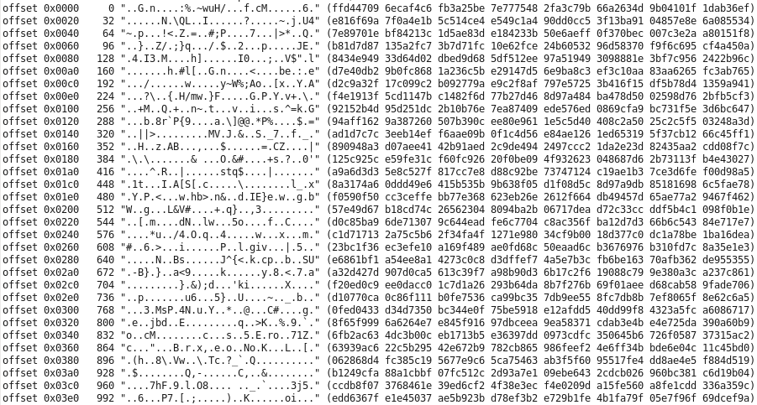
pattern=random
Random binary data
(incompressible)

Slide 37
pattern=trailing_blanks,compressibility=33%,blocksize="1 KiB"
buffer contents:
offset 0x0 (0) "[.....7hHlL.U=.....~QPC...W.H.$." (5b81c8e7 f3193768 486c4cc4 553df104 93e1937e 5150431e 05f457ce 48b024d0)
offset 0x20 (32) ".4.............<.3.../.....#...." (89348d95 018b9d06 c8cff3ba 88a5113c e133bb01 fd2fbfb7 f5001d23 1a089c11)
offset 0x40 (64) "X..W.&.K.?.v......g.z..d.....]qe" (58ccfe57 b926a94b 063fa276 d719abb0 0d1d67e8 7ab5b064 c49bd00e c05d7165)
offset 0x60 (96) "4....+..M..!B35.I..j...1.a..K..." (34d7bc0f db2bd11b 4deea721 42333596 49cbd96a 98f4c331 f461b512 4bd4f501)
offset 0x80 (128) ".g..vv...Q...|.....6..f..o.b..{." (c0678a03 7676d299 a75108ce 057cea9a dfe81336 cba3660f d86fff62 d7b97b11)
offset 0xA0 (160) ".....fQ.:;}k..Z.3...fA".....X..." (12b00084 de6651cc 3a3b7d6b f8a85abe 33d4b2cb 6641220f baf4e815 5809c61c)
offset 0xC0 (192) "..&E=;q.w-.~.^q...8...jJ.{...yD." (08c62645 3d3b719f 772da47e 0b5e71c0 df843884 19866a4a 867ba1f4 b57944d4)
offset 0xE0 (224) ".C$..........+&...~]a..."2.Z..6." (d84324f2 b0f517c1 96b7e0f7 012b2601 8ab57e5d 61ecd68a 2232d65a bb9036a0)
offset 0x100 (256) ".a...[Y..pl........%IN.Z(....3.." (cf610004 cf5b5913 bc706c19 0d92ebcb 1aaaad25 494e125a 28adedd4 a233efe3)
offset 0x120 (288) "..vO.....:..Y7....|..}.. 5.\.(+i" (c7d9764f 94d9ceb1 923afbe0 5937b2b0 aff07c1a 8f7d160d 2035ce5c cc282b69)
offset 0x140 (320) "..\......M...{y/%F...L..=..m...." (e5d85cd8 a0ae13e2 144d84d8 027b792f 25461ac6 1a4caefb 3ddc816d bdabbb85)
offset 0x160 (352) "...o....9.....*.j..s..%.....A\.." (cab2c06f a3e8d79a 399edda9 ccbf2abc 6a98f173 b5bd25a2 d2e6cf86 415ce5d3)
offset 0x180 (384) "SZ...x.S/+.b,<.A6....,...F..|p^5" (535ab9ee c778eb53 2f2b0362 2c3c1d41 3699b693 0b2c92ea 9a46f5b8 7c705e35)
offset 0x1A0 (416) ". F......O&......gVP.J...e'...n." (e22046ce b98dd817 ba4f26b6 de7fb8fa 80675650 aa4ab6f4 806527ce f49c6eb4)
offset 0x1C0 (448) "_.N..G...3 ...L...*.t.db.#..!.." (5fe34eb8 1147d115 d4332020 10ea0f4c ead6a62a b074a664 62df2311 c32100cf)
offset 0x1E0 (480) ".W....A.(.DA....axY]....h9'....)" (a557019d b6e34190 28974441 1fa2bca0 6178595d 0ff416af 683927c2 acc9f229)
offset 0x200 (512) ">O.._..j...9^....K;+...@^....K<." (3e4f0a02 5fa4f66a 04a6d239 5eafdda7 0c4b3b2b 8782ff40 5e9019a4 194b3cd6)
offset 0x220 (544) "DL|N......_.uV(.Og.... q.%...v.." (444c7c4e 8b96f9fd 148f5f04 7556288e 4f67c5c8 9acb2071 ed25acc4 8f769cc4)
offset 0x240 (576) "M...r.x..F.v ....4_.P....0.z..K2" (4df1ade6 72c978f5 d846fb76 20940cc6 ed345ff1 500da10a 8930ef7a 0bb14b32)
offset 0x260 (608) "e....[:y.P..H.^*.dX........M..Ye" (65f2f5e8 b45b3a79 a650e78e 488f5e2a c8645883 87ebef0e 929aae4d 0aef5965)
offset 0x280 (640) "j......H)P8....e.............9N." (6abfd4c8 fe06c648 295038e4 fae3b165 ecc390b7 f7e799a3 fd1ca8e5 c4394eb5)
offset 0x2A0 (672) "\d..{.`..y " (5c6418cb 7bff6015 df792020 20202020 20202020 20202020 20202020 20202020)
offset 0x2C0 (704) " " (20202020 20202020 20202020 20202020 20202020 20202020 20202020 20202020)
offset 0x2E0 (736) " " (20202020 20202020 20202020 20202020 20202020 20202020 20202020 20202020)
offset 0x300 (768) " " (20202020 20202020 20202020 20202020 20202020 20202020 20202020 20202020)
offset 0x320 (800) " " (20202020 20202020 20202020 20202020 20202020 20202020 20202020 20202020)
offset 0x340 (832) " " (20202020 20202020 20202020 20202020 20202020 20202020 20202020 20202020)
offset 0x360 (864) " " (20202020 20202020 20202020 20202020 20202020 20202020 20202020 20202020)
offset 0x380 (896) " " (20202020 20202020 20202020 20202020 20202020 20202020 20202020 20202020)
offset 0x3A0 (928) " " (20202020 20202020 20202020 20202020 20202020 20202020 20202020 20202020)
offset 0x3C0 (960) " " (20202020 20202020 20202020 20202020 20202020 20202020 20202020 20202020)
offset 0x3E0 (992) " " (20202020 20202020 20202020 20202020 20202020 20202020 20202020 20202020)
Leading part of block is random binary data
(incompressible)
compressibility = 33% means 33% trailing blanks

Slide 38
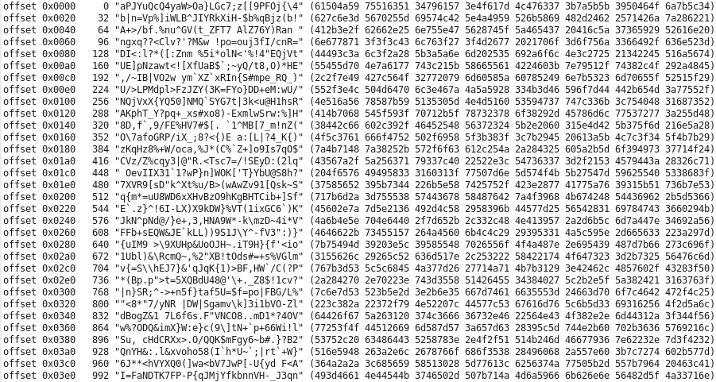
pattern=ascii
Randomly selected printable ASCII characters
(fixed degree of compressibility)

Slide 39
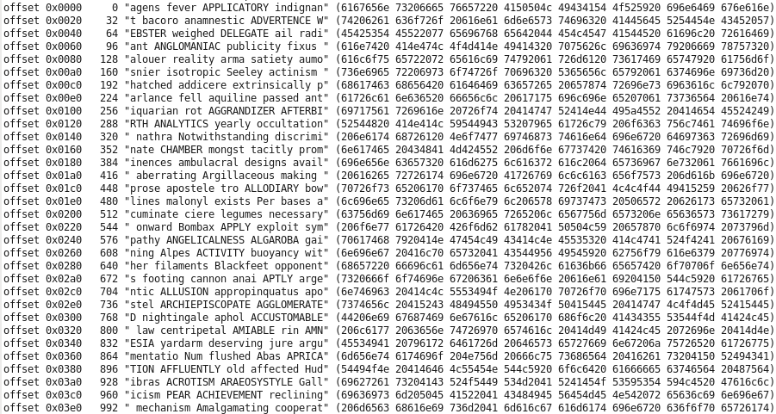
pattern=gobbledegook
Randomly selected words from Webster's 1913 dictionary.
(fixed degree of compressibility)

Slide 40
Random workload "hot zone" – induce specified hit rate
The random_steady and random_independent iosequencer types support optional "hot zone" parameter settings
The random I/O "hot zone" receives a specified fraction of all I/Os.
The hot zone fraction of I/Os is a number from 0.0 to 1.0 or from 0% to 100%.
Use hot_zone_IOPS_fraction to control both reads & writes
Use hot_zone_read_fraction or hot_zone_write_fraction to control them separately
Usually the default size hot_zone_size_bytes = "1 MiB" is fine.
KiB/MiB/GiB/TiB suffixes OK.
This is an open-loop method of achieving a target subsystem cache hit ratio with what is otherwise a perfectly even random distribution.

Slide 41
"hot zone" notes
The value the user specifies for hot_zone_size_bytes is rounded up to the next higher multiple of the blocksize parameter value.
The "hot zone" starts at the beginning of the LUN coverage area specified by RangeStart (default 0% of the way through the LUN).
The "hot zone" is designed to service hot zone hits as well as non-hot zone misses with the same set of tags, that is, within the same ivy workload.
There is no separate reporting of the hot zone as the csv files are by workload.
Hot zone I/Os go to random locations within the hot zone.

Slide 42
Statements - [DeleteWorkload]
[DeleteWorkload] "r_steady" [select] "LDEV : 00:04";
[DeleteWorkload] "r_steady" ;
Deletes all instances of the r_steady workload on all test hosts / all LUNS.
[DeleteWorkload] ;
Deletes all workloads. (All workloads are automatically deleted when ivy ends.)

Slide 43
Workload parameter – “skew” or “skew_weight”
The “skew” or “skew_weight” (use either name) parameter must be set to a non-zero number, defaulting to -1.0,
Skew is used for two distinct purposes:
With “Edit Rollup”, skew governs the distribution of a fixed total_IOPS value across LUNs and the workloads on those LUNs.
Works identically whether skew is positive or negative.
Total_IOPS value is first evenly distributed over LUNs, and then within the LUN proportional to each workload’s skew value.
Where there are multiple IOPS=max workloads on a LUN, a positive skew value for a workload causes the ratio of the IOPS of each positive-skew with IOPS=max workload to be proportional to that workload’s positive skew value.
If an IOPS=max workload has a negative skew, it will run independently without reference to any other IOPS=max workloads.

Slide 44
Skew example with Edit Rollup & total_IOPS
[hosts] "sun159" [select] << { "serial_number" : 83011441 } >>; [CreateWorkload] "r_steady" [select] "" [iogenerator] "random_steady“ [parameters] << blocksize=4KiB, maxtags=1, fractionread=0.5, RangeStart=0.0, RangeEnd=0.5 >>; [CreateWorkload] "r_independent" [select] "" [iogenerator] "random_independent" [parameters] << blocksize=4KiB, maxtags=1, fractionread=0.5, RangeStart=0.5, RangeEnd=1.0, skew = 2 >>; [edit rollup] "all=all" [parameters] "total_IOPS=1000"; [Go] "stepname=step_eh, measure_seconds = 30";
“skew” not specified, defaults to -1.0
“skew” specified as 2.0
total_IOPS is first divided by the number of LUNs on all hosts behind the “all=all” rollup, then the IOPS per LUN is divided up in the ratio to 1 part r_steady to 2 parts r_independent.

Slide 45
Skew example with IOPS=max
[hosts] "sun159" [select] << { "serial_number" : 83011441 } >>; [CreateWorkload] "r_steady" [select] "" [iogenerator] "random_steady“ [parameters] << IOPS=max, skew = 1, blocksize=4KiB, maxtags=8, fractionread=0.5, RangeStart=0.0, RangeEnd=0.5 >>; [CreateWorkload] "r_independent" [select] "" [iogenerator] "random_independent" [parameters] << IOPS=max, skew = 2, blocksize=4KiB, maxtags=1, fractionread=0.5, RangeStart=0.5, RangeEnd=1.0 >>; [Go] "stepname=step_eh, measure_seconds = 30";
“skew” = 1
“skew” = 2
One third of the IOPS will come from the workload with skew=1, and two thirds will come from the workload with skew=2

Slide 46
What is an ivy "rollup"?
A "rollup" is a grouping of workloads.
Each workload is attached to a LUN, and this LUN has attributes like "Port", "LDEV", "LDEV type", "Pool ID", "Parity Group", "Consistency Group", "Serial Number", "Host", "Size GiB", "Vendor", "Product", "Port WWN", "CLPR", etc. These come from "showluns.sh".
A "rollup" is a way of grouping the workloads by LUN attribute.
No matter how you created the workloads, whether you selected by one of these attributes, or if you just created workloads on all available test LUNs, to get output data sliced and diced by port, say [CreateRollup] "port";
The "port" rollup has instances like "1A", "2A", etc.
Every workload (like sun159+/dev/sdc+frantic) belongs to exactly one instance in every rollup.
You can make multiple rollups on different attributes to get data sliced & diced in different ways.

Slide 47
Rollups are key to how the ivy engine works
Rollups are used to group workloads, to navigate between (in both directions), say, a port name 1A and those workloads on LUNs mapping to port 1A.
By-rollup csv files show data rolled up by rollup instance from results by individual WorkloadID.
[EditRollup] uses rollups in the other direction, to send, for example, IOPS=1000 to the workloads on port 1A.
When driving multiple subsystems: [CreateRollup] "serial_number+port";
serial_number and port must be valid LUN attribute names.
In every rollup, each WorkloadID appears in exactly one rollup instance.
"Serial_Number+Port"
"410123+1A"
"sun159+/dev/sdx+workload_name", "cb28+/dev/sdy+workload_name"
Rollup type
List of WorkloadIDs comprising the rollup instance
Rollup instance.
To print this rollup structure out, say print(ivy_engine_get("rollup_structure"));

Slide 48
You make rollups for four reasons
To get an output csv file with a csv folder by rollup type (e.g. port) and csv files by rollup instance (e.g. 1A)
This is how you get custom "sliced & diced" data.
To perform IOPS dynamic feedback control (dfc=PID) at the granularity of the rollup instance.
One of the demos shows measuring IOPS at MP 50% busy at the granularity of the MPU, meaning to vary the IOPS up and down separately/independently for each MPU to achieve 50% busy MP cores in that MPU.
To identify a valid measurement period at the granularity of the rollup instance using measure.
For the valid period, when measuring at the granularity of the rollup instance, the data for each rollup instance individually met the +/- accuracy % criteria for a valid measurement. (For every port, the individual data for that port met the +/- accuracy criterion.)
To validate the test configuration as operating correctly
E.g. Validates that the number of ports reporting was what you expected
E.g. Validate that no one port had an IOPS too far below the highest IOPS seen on any port.

Slide 49
Statements – [CreateRollup]
[CreateRollup] "port" [nocsv] [quantity] 64 [MaxDroop] "20%";
[nocsv] - Optional - suppresses creation of port output csv files for this rollup.
[quantity] 64 - Optional - marks the test result invalid if there aren’t 64 port instances reporting data .
[MaxDroop] "20%"
Optional - marks the test result invalid if any one instance of the rollup has an IOPS more than 20% below that of the fastest instance.
Useful to catch the situation where, say, one port is running slowly compared to the others because it’s in error recovery.

Slide 50
The "all" rollup
There is always a special "all" rollup which only has one instance "all".
The "all=all" instance contains all workloads.
The "all" rollup is automatically created, and you cannot delete it.
For example [EditRollup] "all=all" [parameters] "IOPS=max"; will set IOPS=max in every workload.
Every rollup has its summary csv file folder in the [OutputFolderRoot] directory.
Look at the "xxx.all.summary.csv" file in the "all" subfolder of the ivy output folder to get the overall summary data.

Slide 51
[CreateRollup] combines LUN attribute names
If you would like to see a rollup instance for each unique LDEV across two or more subsystems, make "serial number+LDEV".
[nocsv] – prevents csv files from being created.
The [quantity] <int expression> clause can enforce that the right number of distinct rollup instances are reporting in this rollup.
If not, even if the DFC reports "success" and designates a subinterval subsequence representing a successful measurement, no measurement rollup csv data will be produced – instead error msg.
Make a rollup by "port" and use the [quantity] rollup to validate you have the number of paths you think you have.
[MaxDroop] <double expression>
"25%" means invalidate test if any one rollup instance has an average IOPS more then 25% below the highest average IOPS over all rollup instances.

Slide 52
[DeleteRollup]
[DeleteRollup] "serial number+Port";
[DeleteRollup] ;
Deletes all rollups except the "all" rollup.

Slide 53
[EditRollup]
[EditRollup] "serial_number+Port = { 410123+1A, 410123+2A }" [parameters] "fractionRead = 100%";
The [EditRollup] statement operates in between test steps while the workload threads are in "waiting for command" state.
It gives you access to the same mechanism used by Dynamic Feedback Control to send out real time parameter updates to running workload threads.
You specify a set of rollup instances to send to, such as "all=all", or "Port={1A,3A,5A,7A}" and you specify the text [parameters] string to send to the remote iosequencer to parse and apply.

Slide 54
[EditRollup]
[EditRollup] is typically used at the top of a do-loop, to change whatever parameters vary by loop pass.
Use [EditRollup] "all=all" to send to all workload threads.
There is a special parameter name that is only recognized by [EditRollup] - total_IOPS - where the numeric value you specify is first evenly divided amongst all test LUNs, and then within each LUN, proportional to the absolute value of each workload’s skew parameter before being sent out as IOPS=xxx to each workload.
[EditRollup] "all=all" [parameters] "total_IOPS = 1000000";

Slide 55
[EditRollup] attributes names containing spaces
Many attributes names contain spaces, like "serial number".
Inside the ivy engine, when making rollups, these attribute names are “normalized”
All alphabetic characters A-Z are converted to lower case a-z.
All sequences of one or more non-alphanumeric characters (not A-Z, not a-z, not 0-9) are replaced with a single underscore _.
When creating, deleting, or editing rollups with attribute names containing spaces, you can either put quotes around the attribute combo name, like [EditRollup] << "Serial Number+Port" = { 410123+1A, 410123+2A } >> … or else to avoid using quotes, you can spell the attribute names using underscores instead of spaces and special characters. Once the attribute names haves been normalized, these are equivalent. [EditRollup] << Serial_Number+Port = { 410123+1A, 410123+2A } >> …

Slide 56
Statement – [Go]
[Go] "stepname = random4K, subinterval_seconds = 5, …"
The [Go] statement starts the workload threads running a "test step", which is a sequence of "subintervals" each of a duration specified in the subinterval_seconds parameter, defaulting to 5 seconds.
If you have a case for using ivy to measure a restricted set of things much more frequently, we can talk about putting in support.
Most of the time 5 seconds is plenty short and if you are going to be doing any tests that will run for hours you may want to consider a longer subinterval just to mercifully cut down on the size of the csv files by subinterval.
Sometimes when you say you want an answer to +/- 1% and the behaviour is a bit noisy, it can take time to see enough to say you are sufficiently confident statistically. (Did you say you wanted "valid" data?)

Slide 57
Test step = warmup, measure, cooldown
warmup
measurement
cooldown
Subinterval 0
Subinterval 1
Subinterval 2
Subinterval 3
Subinterval 4
First measurement subinterval
Last measurement subinterval
There must be at least one measurement subinterval. Warmup & cooldown are optional.
Parameter defaults
warmup_seconds – defaults to the value of subinterval_seconds, which itself defaults to 5 seconds. warmup_seconds is divided by subinterval_seconds, and rounded up to get the (minimum) number of warmup subintervals.
measure_seconds defaults to 60 - also rounded up to the minimum number of measurement subintervals.
cooldown_seconds defaults to 0.
cooldown_by_wp = on - If a command device is available for the subsystem under test, the cooldown period is extended until write pending is below subsystem_WP_threshold which defaults to 1.5%.
cooldown_by_MP_busy = on - If a command device is available for the subsystem under test, the cooldown period is extended until average subsystem MP_core % busy is below subsystem_busy_threshold which defaults to 5%.

Slide 58
MM:SS or HH:MM:SS are OK
For warmup_seconds, measure_seconds, cooldown_seconds, and also for a parameter we haven't discussed yet, for timeout_seconds, it's OK to specify a value like 10:00 meaning 10 minutes, or 10:00:00 meaning 10 hours.

Slide 59
Sequential fill
To ensure that a test step runs at least until all sequential write threads have wrapped around and have written to all possible blocks:
[Go!] " … sequential_fill = on … ";
At the point where a successful measurement (of either fixed or variable duration) would have been declared, with sequential_fill=on the measurement period is automatically extended from then until sequential fill is complete.
Sequential fill progress is 40.46% after 0:02:51. Estimated remaining 0:04:11 to complete fill at 2017-04-22 11:24:19.
Even when sequential_fill is not on, when writing sequentially you'll get this same sequential fill progress message on the console.

Slide 60
For each test step (for each [go]) you get:
A subfolder of the overall test output folder that contains the csv files with one line for each subinterval in that test step. (suppress this with –no_stepcsv.)
Nested subfolders for each workload data rollup
Containing a csv file for each rollup instance, with one line per subinterval.
For internal Hitachi lab use with command device connector and license key, a nested subfolder with raw RAID_subsystem RMLIB API data. (Suppress with –no_storcsv.)
Collected time-synchronized "just before" the end of each subinterval.
A single line in the overall test results "summary.csv" files.
In ivy terminology, this is called a "measurement" line, which represents the rollup from the first to last measurement subintervals.
Unless "measure=on" with specified accuracy timed out – then you get an error message line
Well, actually, with DFC=IOPS_staircase, you get one line per staircase step.

Slide 61
Provisional by-subinterval csv files
Unless suppressed with –no_stepcsv, a subfolder is made for each test step with by-subinterval csv files for each rollup instance.
Normally csv files are written at the end of a test step when the subinterval sequence is finished. (Data are kept in memory until then.)
The by-subinterval csv files lines have a warmup / measure / cooldown column. This column can't be determined until after the subinterval sequence is done, and the "measure" feature has decided.
To get provisional by-subinterval csv files with a blank warmup / measure / cooldown column written while subintervals are running, say ivy_engine_set("provisional_csv_lines","on"); in your ivyscript program before [go].
This way you can kill ivy with ctrl-C while it's running, and still see the by-subinterval data up until then. Of course you won't get a summary csv line for that step that was running.

Slide 62
Looping within a [Go] statement
[go] << blocksize = ( "2 KiB", "4 KiB"), maxTags = (1, 2, 4, 8), measure_seconds = 1:00 >>
The syntax is <workload parameter name> = ( value1, value2, …)
The use of parenthesis () is mandatory, and this is what tells the ivy engine that the parameter name is a workload [parameters] name, not a [go] parameter name.
The first <workload parameter name> = ( value1, value2, …) becomes the outer loop, and so forth. Thus you can control the order of the nesting of the loops.
A test step is run for each loop pass, that is, for each combination of parameter values.

Slide 63
Looping within a [Go] statement – IOPS_curve
IOPS_curve = ( 10%, 20%, 0.8, 0.9)
This is a special kind of looping within a [Go] statement which prepares for the first loop pass by doing: [EditRollup] "all=all" [Parameters] "IOPS=max";
The achieved IOPS measured on the IOPS=max loop pass is then multiplied by the specified fractions to prepare for subsequent passes using: [EditRollup] "all=all" [Parameters] "Total_IOPS=xxx";
When combined with looping over other workload parameters, normally the IOPS_curve loop is specified last so it becomes the innermost loop.
This is because changing other parameters within an IOPS_curve loop may affect the measured max IOPS.

Slide 64
cooldown_seconds
Cooldown runs at IOPS=0.
Use cooldown_seconds to run at IOPS=0 for a fixed time period to allow for the test configuration to recover from the ivy test step that's ending, such as to give time for dirty data to destage from cache.
Here there's no feedback from the storage to know when the recovery period is complete; cooldown just runs for a fixed period.

Slide 65
cooldown_by_wp & cooldown_by_MP_busy
These are available for Hitachi internal lab use with a command device connector and license key. The command device connector is not part of the ivy open source project.
When cooldown_by_wp and/or cooldown_by_MP_busy are being used, additional cooldown subintervals run at IOPS=0 until Write Pending is empty, and/or subsystem MP % busy has dropped below the threshold, respectively.
Defaults: cooldown_by_wp = on and subsystem_WP_threshold = 1.5%
Set cooldown_by_wp = off
When it is valid to carry forward dirty data in cache (Write Pending) from one test step to the next.
This can speed up the next test step if the next step doesn’t stabilize until WP is full, AND if both steps place the SAME things into WP that destage to the SAME place.
Defaults: cooldown_by_MP_busy = on and subsystem_busy_threshold = 5%
This extends cooldown until any residual subsystem microprocessor activity has ended.
cooldown_by_MP_busy_stay_down_time_seconds (default one subinterval) specifies how long MP busy must remain below the threshold. Can be specified as “1:00” meaning a minute.

Slide 66
no_perf = on
With a command device (Hitachi lab use only), this suppresses collecting performance data from the subsystem only while ivy is driving I/O.
This can be useful if every subsystem port is being driven intensively, and thus would interfere with communicating with the command device, which is on one of the ports.
When used with cooldown_by_wp or cooldown_by_MP_busy, after the first cooldown subinterval while I/O is still being driven, during subsequent subintervals at IOPS=0, even with suppress_perf=on, collection of performance data from the subsystem resumes to provide the necessary Write Pending % and subsystem MP % busy information to support the cooldown_by_wp and cooldown_by_MP_busy features.
The –no_perf ivy command line option sets the default [Go] statement no_perf parameter to “on” instead of “off”.

Slide 67
skip_LDEV = on
The collection of LDEV data (which is also the source for PG data) is the most resource intensive part of collecting real time subsystem performance data.
For Hitachi internal lab use with a command device, skip_LDEV=on is a [Go] statement parameter that will suppress collection of LDEV and PG performance data.
This can reduce the amount of communication with the subsystem required, if the command device LUN is on the same port as very-heavily driven data LUNs.
This still lets you do dynamic feedback control on other metrics such as subsystem MP % busy.
The –skip_LDEV ivy command line option sets the [Go] statement default skip_LDEV parameter value to “on” instead of “off”.

Slide 68
check_failed_component = on / off
For Hitachi internal lab use with a command device, this [Go] statement parameter controls whether ivy checks the subsystem for a failed component.
With check_failed_component = on, as each [Go] statement is executed, a check for a failed subsystem component is made immediately before I/O starts to be driven, and also immediately after the subinterval sequence is done and before csv files are printed. Ivy aborts when one of these checks detects a failed subsystem component.
The default is check_failed_component = on, except if the command line parameter -no_check_failed_component is used, which sets the default for check_failed_component to off.

Slide 69
The default [Go] statement
[go]; Useful when you are developing an ivyscript workflow and you just want to see quick sample csv files.
Default subinterval_seconds = 5
warmup_seconds defaults to the value of subinterval_seconds.
Default measure_seconds = 60
Runs at least one cooldown subinterval.
Defaults cooldown_by_wp = "on" and subsystem_WP_threshold=1.5%
If you have a command device and the proprietary command device connector software, continuing more cooldown subintervals until WP is below threshold.
Defaults cooldown_by_MP_busy="on" and subsystem_busy_threshold=5%
If you have a command device and the proprietary command device connector software, continuing more cooldown subintervals until MP_core % busy is below the threshold.

Slide 70
stepname
On the [Go] statement to start a test step, you can optionally specify "stepname=", which defaults to "step" followed by a four digit step number starting with 0000, so the default name for the first step is step0000.
Giving a test step a meaningful name is useful when looking at overall measurement summary csv files, where you get one csv line for each test step.
Those labels are handy when making Excel charts, as you can use the stepname column as the series name on a chart.

Slide 71
measure shorthand
measure = MB_per_second is short for
measure=on, focus_rollup=all, source=workload, category=overall, accumulator_type=bytes_transferred, accessor=sum
measure = IOPS is short for
measure=on, focus_rollup=all, source=workload, category=overall, accumulator_type=bytes_transferred, accessor=count
measure = service_time_seconds is short for
measure=on, focus_rollup=all, source=workload, category=overall, accumulator_type=service_time, accessor=avg
measure = response_time_seconds is short for
measure=on, focus_rollup=all, source=workload, category=overall, accumulator_type=response_time, accessor=avg
Advanced things for the ivy power user.
These give access to internal ivy mechanisms.
Explained in a separate section.

Slide 72
measure shorthand – with command device
measure = MP_core_busy_percent is short for
measure=on, focus_rollup=all, source=RAID_subsystem, subsystem_element=MP_core, element_metric=busy_percent
measure = PG_busy_percent is short for
measure=on, focus_rollup=all, source=RAID_subsystem, subsystem_element=PG, element_metric=busy_percent
measure = CLPR_WP_percent is short for
measure=on, focus_rollup=all, source=RAID_subsystem, subsystem_element=CLPR, element_metric=WP_percent
Advanced things for the ivy power user.
These give access to internal ivy mechanisms.
Explained in a separate section.

Slide 73
[Go] "focus metric"
If you want to run a fixed workload for a fixed number of subintervals, all you need is measure_seconds.
Otherwise, we need to specify the "focus metric".
The focus metric is what we are making a valid measurement of using measure and accuracy_plus_minus.
Measure the focus metric to a required plus/minus accuracy with a specified % confidence level.
When dynamically adjusting total_IOPS using the PID loop dynamic feedback controller (dfc=pid), the focus metric is the "feedback" in dynamic feedback control.

Slide 74
Granularity of the "focus metric"
When measure and/or dfc = pid are used, measurement or PID loop DFC is performed at the granularity of each instance of the focus_rollup.
For the default, focus_rollup = all, the measurement or DFC is at the overall level.
When a focus_rollup is used that has multiple rollup instances,
With measure, a successful measurement identifies a subsequence of subintervals where for every rollup instance within the focus_rollup, the measurement is valid for that rollup instance.
When dfc=pid is used, dynamic feedback control is performed independently for each rollup instance in the focus_rollup.

Slide 75
Subsystem data filtered by rollup instance
The way this works is via a "config filter" that is prepared in advance before a subinterval sequence starts.
For each thing you get data for, such as PG, or LDEV, or MPU, etc., the config filter has the set of instances of PG or LDEV or MPU names that were either
directly observed as a SCSI Inquiry attribute of the LUNs underlying the workloads in the rollup instance, or
observed as an attribute of an underlying LDEV obtained via the RMLIB API, or
which were inferred from static tables of relationships for the particular subsystem model.

Slide 76
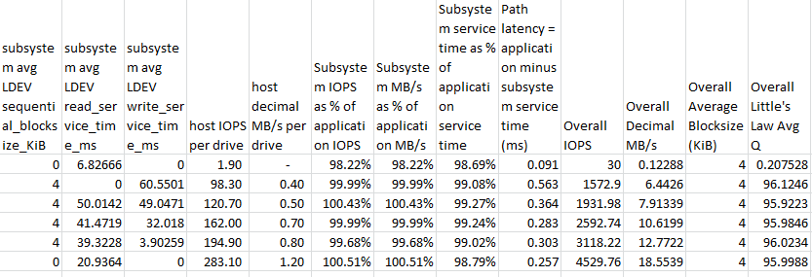
Subsystem data by rollup instance – csv columns
We know how many drives underlie each workload rollup
Shows you if the OS / device driver are breaking up your large block application-level I/O into smaller pieces
Matching subsystem vs. application data validates that both host-workload rollups and subsystem data rollups are working correctly
Shows you if there is delay between when the application issues the I/O and when the device driver issues the I/O.
Shows you the amount of that delay in ms.

Slide 77
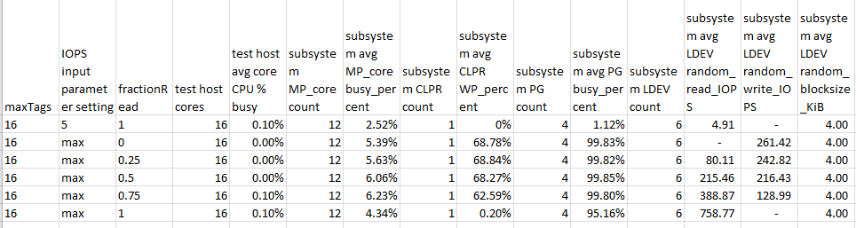
RMLIB API candidates flagged to display
The “subsystem” columns are automatically generated according to the focus metric RMLIB API candidate table.
As raw data comes in for each MP_core, CLPR, PG, LDEV, etc., ivy filters the data to aggregate for each rollup only the data for the MP_cores, etc. that map to LDEVs/LUNs underlying workloads in that rollup.
Make a rollup by MPU, and each MPU rollup instance will show data for 4 MP_cores.

Slide 78
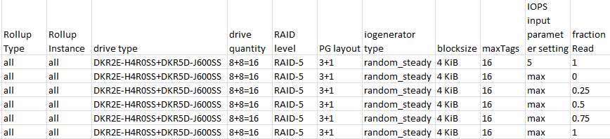
Examples of data for each rollup – drive / PG type
Information comes from RMLIB API configuration data, filtered / aggregated for each rollup instance.
(There are also dedicated csv folders that contain detailed RMLIB API subsystem configuration and performance data csv files.)

Slide 79
Now that we know how to specify the focus metric
We will look at
The [go] statement measure=on option and its subparameters
Specifying measure=on on a Go statement means "watch the focus metric and when you have seen enough to make a measurement of the specified accuracy, stop. Timeout if it takes too long."
The [go] statement dfc=pid option and its subparameters
If you don't specify a dfc, the workload settings remain constant through the test.
If you specify a dfc (dynamic feedback controller), it gets called at the end of every subinterval once all the rollups are done.
The DFC looks at what has happened so far, looking at all workload data and all subsystem data, and then may use the ivy engine real time edit rollup mechanism to send out parameter updates to rollup instances (to the workload threads belonging to the rollup instance).

Slide 80
measure = on
accuracy_plus_minus = 5%
Any numeric value with an optional trailing % sign maybe specified.
confidence = 95%
How confident you need to be that your measurement falls within the specified plus or minus range around the long term average that you would get measuring forever.
Default is 95%
Ivy has a menu of 11 specific pre-loaded confidence values that you pick from.
50%, 60%, 70%, 80%, 90%, 95%, 98%, 99%, 99.5%, 99.8%, and 99.9%
http://en.wikipedia.org/wiki/Student%27s_t-distribution

Slide 81
measure Write Pending-based stability criteria
max_wp = 2% - default 100%
A subinterval sequence will be rejected if WP is above the limit at any point in the sequence.
Set this to "1%' or so for read tests to ensure WP is empty during the test.
min_wp = 67% - default 0%
A subinterval sequence will be rejected if WP is below the limit at any point in the sequence.
Use this for write tests to ensure WP is full during the test.
max_wp_change = 3% - default 3%
A subinterval sequence will be rejected if WP varies up and down by more than the specified (absolute) amount at any point in the sequence. max_wp_range="3%" matches from 0% to 3% Write Pending, as well as from 67% to 70% Write Pending. (not a percent OF the WP value)
Use this in general all the time so you reject periods with major movement in Write Pending.

Slide 82
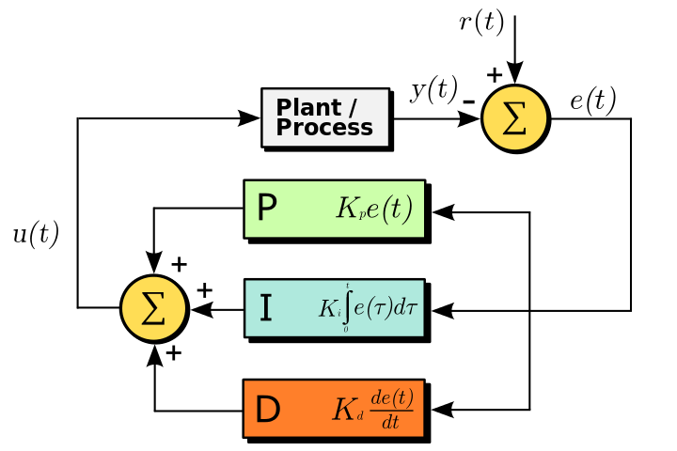
dfc=pid dynamically adjusts total IOPS
See separate presentation "ivy adaptive PID".

Slide 83
DFC = IOPS_staircase
Normally, each ivy “step” runs a subinterval sequence to make one measurement, and then pauses for a very brief time to write csv files before the next step.
DFC = IOPS_staircase is used to make a series of “IOPS staircase step” measurements in one unbroken series of subintervals, continuously driving I/O.
IOPS
Measurement
ending_IOPS
Measurement
step
starting_IOPS
Measurement
Time
Subintervals

Slide 84
DFC = IOPS_staircase
Each measurement is comprised of zero or more warmup subintervals (warmup_seconds)and one or more measurement subintervals (measure_seconds).
The measure feature can be used with DFC=IOPS_staircase, in which case the duration of each step on the staircase is variable, and warmup_seconds & measure_seconds become minimums.
IOPS
Measurement
ending_IOPS
Measurement
step
starting_IOPS
Measurement
Time
Subintervals

Slide 85
DFC = IOPS_staircase
Use starting_IOPS, ending_IOPS and steps, and that many equal height steps are made (shown below).
Use step="+50%" to increase the IOPS by 50% on each step.
You can provide both step (size of step) and steps (number of steps) instead of ending_IOPS.
If “ending_IOPS” is not provided, staircase steps continue until the requested IOPS can no longer be attained.
IOPS
Measurement
ending_IOPS
Measurement
steps = 3
starting_IOPS
Measurement
Time
Subintervals

Slide 86
DFC = IOPS_staircase
cooldown_by_WP and cooldown_by_MP_busy only apply at the end of the test step, that is, after the last measurement in the staircase.
IOPS
Measurement
ending_IOPS
Measurement
Cooldown at IOPS = 0
starting_IOPS
Measurement
Time
Subintervals

Slide 87
DFC = IOPS_staircase
starting_IOPS = nnn, etc. are values used with [EditRollup] "all=all" [parameters] "total_IOPS = nnn";
With edit rollup “total_IOPS”, the total IOPS value is first distributed evenly over all test host LUNs that have workloads defined. These are called “test LUNs”.
Then within each test LUN, its share of total_IOPS is divided up between the workloads on that LUN proportional to the absolute value of the skew parameter of each workload. The resulting value is set as the IOPS for the workload.
skew defaults to -1.0. The negative value means “don’t apply this skew with IOPS=max”.
One of the implications of this is that with DFC=IOPS_staircase, there can be no workloads running at IOPS=max. Every workload gets a share of the total_IOPS setting.

Slide 88
DFC=IOPS_staircase and testing to saturation
Note: The IOPS steps up to the next level up a little bit (less than a second, more typically 1/4 second) after the end of the last subinterval in the previous step.
This means that the very first subinterval in each following step averages a little bit lower than the IOPS setting for that step.
Thus if you have warmup_seconds = 0 with DFC=IOPS_staircase, the steps will tend to be marked "invalid" because the IOPS setting wasn't achieved.
When running with at least one warmup subinterval, this won't happen.
This becomes important with stepping to saturation, because the staircase ends when the IOPS setting hasn't been achieved.
So use at least one warmup subinterval when testing to saturation.

Slide 89
achieved_IOPS_tolerance
ivy_engine_get("achieved_IOPS_tolerance") ivy_engine_set("achieved_IOPS_tolerance","0.25%")
When running at a specific IOPS numeric value (that is, not running IOPS=max), the measurement will be marked "invalid" if the achieved IOPS is more than achieved_IOPS_tolerance different from the (rollup instance's) Total_IOPS setting.
This is also the criterion that determines when to stop a DFC=IOPS_staircase run to saturation that doesn't specify an ending_IOPS or equivalent. The staircase will stop after a step that fails to achieve its IOPS setting.
The default achieved_IOPS_tolerance is 0.25%. This is good for the vast majority of cases.

Slide 90
[Go] parameter summary with defaults 1/2
Overall
stepname = stepNNNN
subinterval_seconds = 5
warmup_seconds = same as subinterval_seconds
measure_seconds = 60
cooldown_seconds = 0
cooldown_by_wp = on
subsystem_WP_threshold = 1.5%
cooldown_by_MP_busy = on
subsystem_busy_threshold = 5%
For dfc = pid
low_IOPS, low_target, high_IOPS, high_target, target_value
max_ripple,gain_step, max_monotone, ballpark_seconds
For DFC = IOPS_staircase
starting_IOPS
ending_IOPS
step
steps
For measure = on
accuracy_plus_minus = 2%
confidence = 95%
50%, 60%, 70%, 80%, 90%, 95%, 98%, 99%, 99.5%, 99.8%, or 99.9%
max_wp = 100%
min_wp = 0%
max_wp_change = 3%

Slide 91
[Go] parameter summary with defaults 2/2
Focus metric
focus_rollup = all
source = ""
or workload / RAID_subsystem
subsystem_element = ""
element_metric = ""
category = overall
or read, write, random, sequential, random_read, random_write, sequential_read, sequential_write
accumulator_type = ""
or bytes_transferred, service_time, response_time
accessor = ""
avg, count, min, max, sum, variance, standardDeviation

Slide 92
A general note on ivy parameter names
Ivy "normalizes" all user-specified parameter names by converting to lower case and removing underscore _ characters
For example, maxTags may also be written max_tags or MAXTAGS.
You can also say [ create workload ] instead of [CreateWorkload].

Slide 93
When a test host gets too hot
ivydriver checks the CPU temperature once per subinterval.
When the hottest core gets within 5 degrees Celsius of the critical limit, ivydriver starts issuing <Warning> messages.
NOTE: We have seen CPU throttling and even machine checks appear in this range. Check system logs.
When the hottest core actually hits the critical temperature and the CPU is definitely throttled or temporarily paused, the default behaviour is to issue an <Error> message and abort.
Default is ivy_engine_set("critical_temp","error")
Alternative is ivy_engine_set("critical_temp","warn")
NOTE: this ivy_engine_set must come before the [hosts] statement to be effective.
With "warn", if the CPU stops for several seconds, you may need to run with a longer subinterval_seconds on the [go] statement.

Slide 94
Measuring submit times
ivy uses the Linux kernel native Asynchronous I/O (AIO) interface. This interface lets one process thread to issue multiple I/Os without waiting for the I/Os to complete. Normally, the AIO io_submit() call is non-blocking, meaning it returns right away. But sometimes it can block or wait for the duration of an I/O.
In ivy the "service time" is from immediately before the submit call until immediately after harvesting the I/O completion event using the io_getevents() call.
The "response time" in ivy is from the scheduled starting time for the I/O, which may be some time before an AIO "slot" becomes available to start the I/O, until immediately after the completion event has been harvested.
The "submit time" is from immediately before the submit call until immediately after the submit call.
The default is to not measure this, thus saving some CPU cycles.
Default is ivy_engine_set("measure_submit_time", "false")
Alternative is ivy_engine_set("measure_submit_time", "true")
NOTE: this ivy_engine_set must come before the [hosts] statement to be effective.

Slide 95
When IOPS is limited by test host CPU % busy
If IOPS is limited by saturated test host CPU % busy, then we are not really measuring the true IOPS capability of the attached storage, and thus the measurement is considered to be invalid.
ivydriver on each test host starts an I/O driving thread bound to each core hyperthread other than the hyperthreads on physical core 0.
The hyperthreads on core 0 are left free to allow for running the ivydriver main thread, and possibly the ivy master host threads, if ivy master is being run on one of the test hosts.
Only the cores (core hyperthreads) whose I/O driving threads have been assigned at least one LUN with attached running workloads are considered to be "active" cores.
If average active core % busy is above "max_active_core_busy" then "invalid" is shown the in the "valid or invalid" column in the summary csv file.
The default is max_active_core_busy = 97%.
To change the setting: ivy_engine_set("max_active_core_busy","97%");

Slide 96
Advanced topics

Slide 97
source of the focus_metric (without shorthand)
source = workload
Specifies that we are selecting a focus metric from data collected by ivy workload threads on test hosts.
We always have rollup data from test host workload threads (more next page)
source = RAID_subsystem
Requires the proprietary command device connector that is not part of the ivy open source project.
Specifies that we are selecting the focus metric from real time performance data collected from a command device.
There's a small list of subsystem metrics specified in an ivy source code table that are filtered and rolled up from the raw bulk RMLIB data by rollup instance, and from which you select the focus metric. (more even later after we explain source=workload)

Slide 98
Selecting a "source=workload" metric
category =
overall, read, write, random, sequential, random_read, random_write, sequential_read, sequential_write
accumulator_type =
bytes_transferred, service_time, response_time
accessor =
avg, count, min, max, sum, variance, standardDeviation
It will be easier to explain first accessor then category, then accumulator_type

Slide 99
Accumulators and "accessor" (without shorthand)
An accumulator is an object that you push numbers into in order to be able to compute summary values.
Every time that an I/O completes, ivy posts the service time into one accumulator, the bytes transferred into another accumulator, and if we are not running IOPS=max, it posts the response time into another accumulator.
The selectable values for "accessor" are the names of the methods that you can use to retrieve something from an accumulator
avg, count, min, max, sum, variance, standardDeviation
avg gives you the average of the numbers that were pushed in the accumulator
count gives you how many numbers were pushed in.
Et cetera.

Slide 100
Attributes of individual I/Os:
read vs. write
blocksize
LBA
Logical Block Address = sector number from 0 within LUN
service_time (in seconds)
The duration from when ivy launched an I/O until ivy received the notification that the I/O was complete.
response_time* (in seconds) (analogue to application-level response time)
The duration from the scheduled start time of an I/O until the time the I/O is complete.
An I/O may not be started at the scheduled time if there are no idle asynchronous I/O "slots" (~tags) available.
*only I/Os with a non-zero scheduled start time will have a response_time attribute.
When running iops=max, all I/Os have a scheduled start time of zero, meaning you don't get response_time.
If IOPS is set to a specific number, but that IOPS is not achieved, response time is suppressed.
Ivy uses the Linux nanosecond resolution clock for all timing

Slide 101
How ivy posts results of each I/O
Based on the attributes of each I/O, an accumulator category is selected.
Then the I/O is posted into the selected category "bucket" (into two or three accumulators in that bucket – more in a moment.)
Currently, the breakdown for the array of categories for which there are accumulators are
read vs. write
random vs. sequential (The I/O sequencer tells you if it's a random or sequential sequencer.)
For each of those 4 there is a further breakdown as a histogram by service time and by response time
You see the histograms in the csv files.
Ivy doesn't currently expose the histogram in the PID loop, but if there is interest it can be added.

Slide 102
Other category breakdowns could be defined
The rollup mechanism operates on a view of the categories as an array, and is blind to the significance of each position in the array.
It is easy to define a different mapping from the attributes of an individual I/O to the category bucket the I/O will be recorded in.
Future:
We could just as easily define a histogram of a 100 buckets by LBA range - we could break out the data by each 1% of the LBA range across the volume.
If we had an I/O sequencer that was playing back a customer I/O trace, we could show if workload characteristics were different in different areas of the LUN.
If we simply run sequential transfers across the LUN, we could see the sustained data rate "staircase" showing the zones in underlying HDDs.

Slide 103
During rollups, the categories are preserved
For the all=all rollup instance, you still have all the category breakdowns.
Then in addition to the category bucket array, there are virtual categories, implemented as functions, which rollup underlying category buckets.
overall – sum over all categories in the bucket array
read, write
random, sequential
random_read, random_write, sequential_read, sequential_write
You can see these virtual category rollups in column groups in ivy csv files.

Slide 104
source=workload available category values
overall read, write random, sequential random_read, random_write, sequential_read, sequential_write
These are actually the virtual categories, representing the rollup over the underlying service time / response time bucket arrays (histograms).
If there is a need, we could provide access to the more fine-grained underlying category bucket array, or we could define other virtual categories as aggregations of the buckets.

Slide 105
source=workload - selecting accumulator
Category buckets have 3 accumulators
accumulator_type = bytes_transferred
For every I/O, the blocksize is posted to bytes_transferred.
Use sum attribute and divide by elapsed seconds to get bytes per second. Use count instead and get IOPS.
accumulator_type = service_time
For every I/O the duration from when ivy started it to when it completed.
service_time and response_time values for I/Os are posted in units of seconds, with nanosecond resolution.
Use "avg" and multiply by 1000 to get average service time in ms.
accumulator_type = response_time (~ application response time)
Only posted for those I/Os that have a non-zero "scheduled time".
Duration from scheduled time to I/O completion time.
The I/O sequencer computes the scheduled time, and when that time is reached, the I/O is started if there is an idle Asynchronous I/O "slot" (~tag) available. If not, it waits.
For IOPS=max, I/Os have a scheduled time of 0 (zero), so then you don't get any response_time events.

Slide 106
Summary: source=workload
category =
overall, read, write, random, sequential, random_read, random_write, sequential_read, sequential_write
accumulator_type =
bytes_transferred, service_time, response_time
accessor =
avg, count, min, max, sum, variance, standardDeviation

Slide 107
source = RAID_subsystem
Subsystem performance data is collected from a command device, and for each subsystem with a command device, there is a subfolder within the test step folder, where each csv file has one line per subinterval within that test step.
You cannot select the focus metric from this raw, bulk subsystem performance data.
A small subset of metrics are extracted from the bulk subsystem data, and filtered and summarized by rollup instance
To serve as candidates for selection as the focus metric
To be printed as columns in rollup instance csv files side-by-side with the columns of host-workload data.
This is controlled by a table in “ivy_engine.h” in ivy source code, which has two levels that you pick from
subsystem_element, and within that, element_metric.
For each metric in the table, you can optionally set a flag to have the value inserted a column side by side with the normal workload data for each rollup instance.

Slide 108
Subsystem metrics by rollup instance
MP_core
busy_percent, io_buffers
CLPR
WP_percent
PG
busy_percent, random_read_busy_percent, random_write_busy_percent, seq_read_busy_percent, seq_write_busy_percent
LDEV
read_service_time_ms, write_service_time_ms, random_blocksize_KiB, sequential_blocksize_KiB, random_read_IOPS, random_read_decimal_MB_per_second , random_read_blocksize_KiB, random_read_hit_percent, random_write_IOPS, random_write_decimal_MB_per_second, random_write_blocksize_KiB, sequential_read_IOPS, sequential_read_decimal_MB_per_second, sequential_read_blocksize_KiB, sequential_write_IOPS, sequential_write_decimal_MB_per_second, sequential_write_blocksize_KiB,

Slide 109
The remainer of this presentation is a draft section describing dedupe=target_spread

Slide 110
Original serpentine dedupe method
The serpentine method writes and average of “dedupe” copies of each new unique data pattern, writes these at the same time regardless of the location being written to.
When writing / filling sequentially, the achieved dedupe ratio is “dedupe”.
When subsequently writing new patterns randomly, each copy goes to a new random location, possibly over-writing one copy of a previous pattern, causing the achieved dedupe ratio to fall over time to an asymptotic limit.

Slide 111
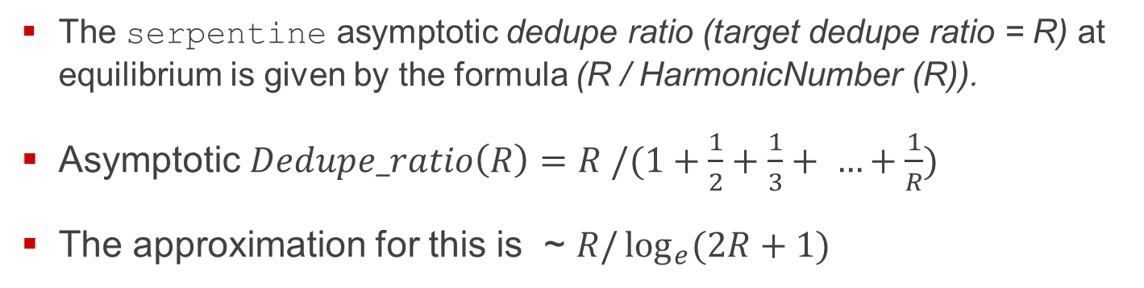
serpentine method, continued
The serpentine asymptotic dedupe ratio (target dedupe ratio = R) at equilibrium is given by the formula (R / HarmonicNumber (R)).
Asymptotic $Dedupe_ratio\left(R\right)=R /(1+\frac{1}{2}+\frac{1}{3}+ …+\frac{1}{R})$
The approximation for this is ~ $R/\log_{e}{(2R+1})$

Slide 112
target_spread method
Pattern Generation changed to achieve the target dedupe ratio with a mix of unique patterns and patterns with higher number of duplicates (target + spread) following a predefined distribution.
For example: Generated pattern sequence for target dedupe ratio of 2.0
P1, P2, P3, P4, P11, P11, P11, P11, P11, P11, P11, P12
Dedupe ratio = (total # of blocks = 12) / (unique blocks = 6) = 2.0

Slide 113
Pattern generation at the “dedupe unit” size
Hitachi Advanced Data Reduction deduplicates at the fixed 8 KiB block size. i.e., at a conceptual “dedupe unit”.
target_spread pattern generation is at the 8 KiB dedupe unit level.
The target_spread pattern sequence generated is based on the distribution (mix of unique blocks and duplicate blocks repeating in a sequence) corresponding to a target dedupe ratio and at the dedupe unit size. The pattern sequence is the same for Sequential or Random writes.
For larger block sizes, the larger block will be filled with blocks of dedupe unit size with the distribution based pattern sequence.

Slide 114
target_spread (continued)
For example, for blocksize = 256 KiB, 32 dedupe unit size blocks are generated and filled – the 32 dedupe unit sized blocks will follow the pattern sequence.
Pattern generation is to be consistent at each LUN and for any reasonably sized (>= 1 GiB) sample set of contiguous blocks.
Unique starting seed for each LUN based off of a universal fixed seed i.e., no deduplication across LUNs (unlike serpentine sequence).
Probabilistic Pattern reuse for Random writes.

Slide 115
Pattern sequence generation algorithm
Each block of data starts with the block_seed and the Eyeo data generator repeatedly runs xorshitft64 to generate a pseudo-random noise as data.
block_seed = pattern_seed ^ pattern_number.
pattern_seed and pattern_number is changed based on a serpentine sequence (old method) or using a distribution (new method) when a new pattern is generated.

Slide 116
Pattern reuse in random writes
Use of universal starter seed
#define universal_seed 1234567 in include/ivydefines.h
Using a generated pod of seeds with the universal seed as a starting seed using the distribution for the target dedupe ratio.
Reuse patterns by readjusting starting pattern_seed and pattern_number.
Pattern seeds are reused with probabilities based on the target dedupe ratio and expected dedupe ratio steady state after multiple random write workloads.

Slide 117
pattern_number_reuse_threshold heuristics
Dedupe ratio dependent threshold to keep pattern numbers in the range: [0..pattern_number_reuse_threshold]
The numeric threshold values in italics were determined based on running modified 6D2P_debup.ivyscript, and dedupe ratios measured using DRE tool.
if (target_dedupe < 2.0)
pattern_number_reuse_threshold =
(1.0 - reuse_probability) * 100000;
else if (target_dedupe > 10.0)
pattern_number_reuse_threshold =
(1.0 - reuse_probability) * 65000;
else pattern_number_reuse_threshold = (1.0 - reuse_probability) * 50000;

Slide 118
target_spread dedupe method implementation
DedupePatternRegulator.{h, cpp}
Responsible for the pattern distribution for target dedupe ratio
Generates a pod of starting seeds on instantiation for reuse in the case of random write workloads
Probabilistic random or reuse of starting seed decision (decide_reuse() method)
Eyeo.cpp
pattern filling with dedupe unit size based blocks from an array of block seeds spanning the xfer size block size
Workload.cpp
Build an array of block seeds spanning an xfer block at dedupe unit boundary for consumption by Eyeo

Slide 119
Thank You

